Slide 1
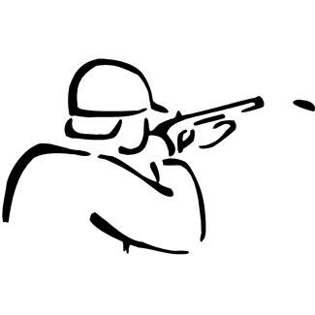
Civil War Information
By Chloe, Derek, Drew, Mary, and Seth

Slide 2
The war started in 1861 and ended in April 1865.
The color of the confederate suits were grey.
The confederate felt that it was ok to own slaves.

Slide 3
Jefferson Davis was the first confederate president.
There was 260,000 dead confederates .
The soldiers got around by train , foot , or horses.

Slide 4
The children would lie to get in the war.
The women would be nurses.
The north had more medicines and more weapons maybe the south wasn’t that lucky.

Slide 5
The war sometimes made families split in half for what they believed in .
The south businesses were black smith, silver smith ,and farmer merchants .
The south wanted slaves so they left the union.

